Slide 1


Test automation practice with Selenium Webdriver
Benkó Adrián
Bondár Tamás
EPAM Systems, Budapest, 2019

Slide 2

Page Object Model Agenda
1
Page Object Model

Slide 3
ChapteR 1
Page Object Model

Slide 4

Page Object Model
Agenda
New Approach
Page Flow
Best practices

Slide 5

Page Object Model
New Approach
Every UI change could cause a lot of test maintenance work
We have to keep maintenance changes as low as possible
We minimize the change sensitive automation code

Slide 6
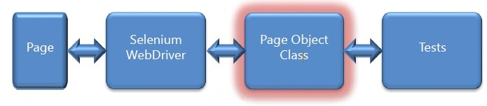
Page Object Model
How to do it
We accept that the application and its elements are bound to change
We create a new layer which contains change prone data
This way we can adapt to changes with minimal refactoring cost

Slide 7
Page Object Model
Rules
What describes one page should be in one class
Use class methods to interact with your page
This class represents your page in the test code
Divide complex pages into smaller components called widgets
Create widgets with the same approach as pages

Slide 8
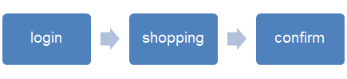
Page Object Model
Page Flow
We want to describe the logical relationship between pages
Manipulation methods should reflect these relationships
We should return a page object class after each method
Return itself if we stay at the same page (e.g. typing)
Return next page if we navigate (e.g. submit)

Slide 9
Page Object Model
Best practices
Create base pages to represent common parts
E.g. same header, footer, sidebar
Reuse common widgets in each affected pages
Use your pages to initiate and confirm the success of navigation
Put your verification methods inside the page object as well

Slide 10
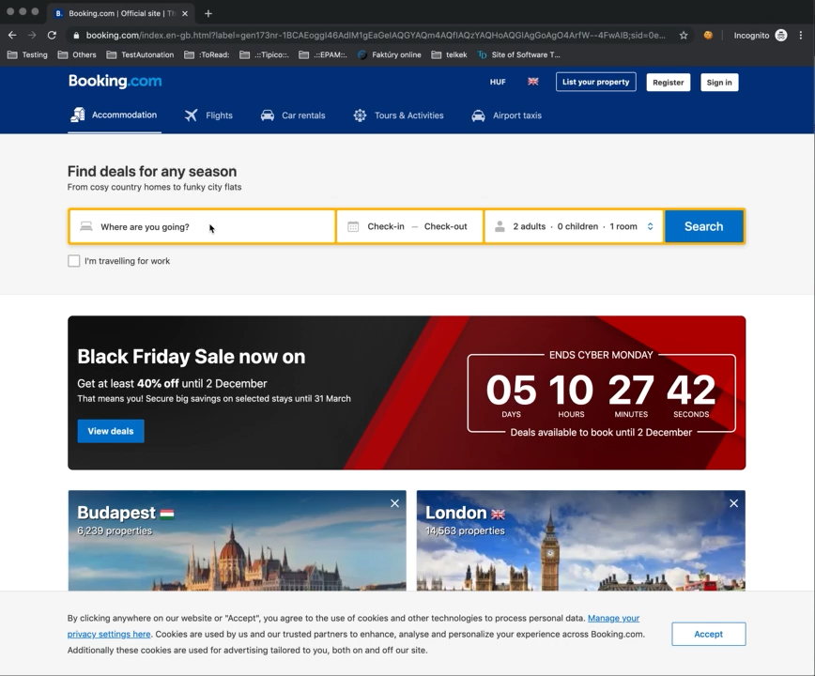
Homework
Video

Slide 11
Homework
Description
Use www.booking.com
Your test should use the “Data Driven” approach for the following dates and Destinations
Xmas: December 24- januar 2, BALI,
Long weekend in March: marcus 13 = marcius 16 , Mezokovesd,
Long weekend in August: augusztus 18 - augusztus 22, Balatonfured
Use Page object models, please
Kindly use the following filters for your search
Only available properties
Breakfast included
Free WiFi
Open the first search result in a new window
And verify that
the Dates are correct (In the Search form on the left)
In the “facilities Checklist” section the “Free WiFi” and “Breakfast included” are available
Create screenshot about this page/property

Slide 12

Questions

